Slide 1
Portfolio website – G Nolan
Aims and priorities
Site outline
Wireframes & basic description
“Mood board” – images, colours, fonts, etc

Slide 2
Aims & Priorities
Showcase skills & technologies
Showcase conformance with industry standards (a11y, responsive, mobile first, validates etc)
Provide central navigation link to projects and own resources
Communicate my character, attitude, and future direction/s
Host any content which aids the above points eg blog posts, reviews of other resources, explanations or mini-lessons on technology-related topics
Provide a means to contact me for professional purposes

Slide 3
Site Outline
Layout ideas:
Logo – tagline - best work - contact info
Good use of whitespace, big background images, illustrations.
Content:
About me – aspiring full stack developer
Early coding
career(RN/aviation/education)
Interests(outdoors/scouting/swim/run/dance)
Skills
Projects
A little fun
Euroballs
Other Codecademy???
Useful things
Timerthing.com
Bacon butty
Socundi
Sailor’s Mate
Future Direction
Blog
Useful Resources
Media & CTA

Slide 4
Wireframes & basic description

Slide 5
Wireframes & basic description
“about me” type area:
Ready
goto:
- Item1
- Item2
- Item3

Slide 6
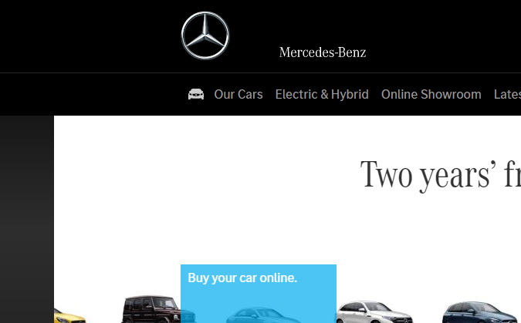

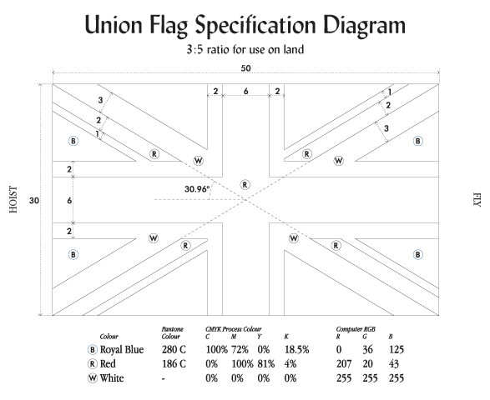


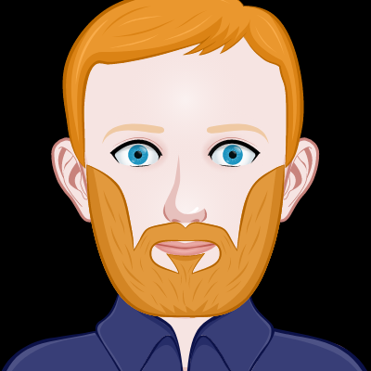


“Mood board” – images, colours, fonts, etc
Union flag:
30:50 ratio
Diagonals 6x(3w/2r/1w)
Red cross 6x
White fimbriation 2x
Blue – rgb(0, 36, 125)
Red – rgb(207, 20, 43)
Some monospace style code-y characters: <> ; {} [] $_ @ ` `
Self as object?!
Use of fragments & links to scroll to sections
Images enlarge slightly on hover
Dark theme, professional, simple, smooth animation on actions (not obtrusive)
Auto-scrolling gallery?
Actions on vert scroll (subtle)

Slide 7
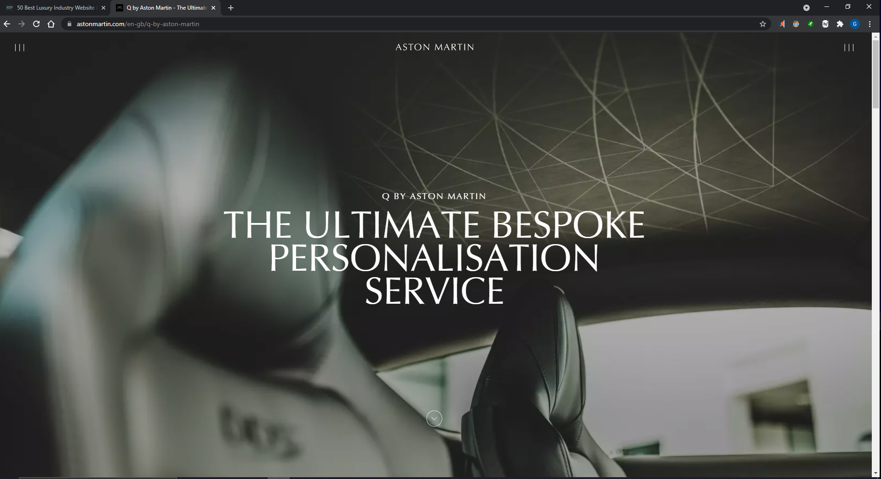
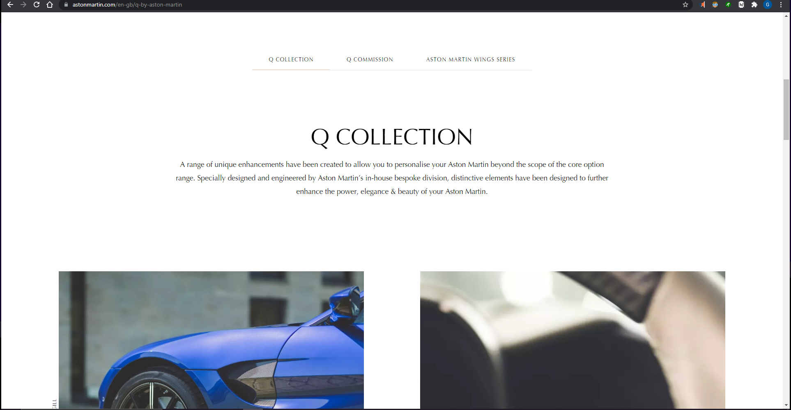
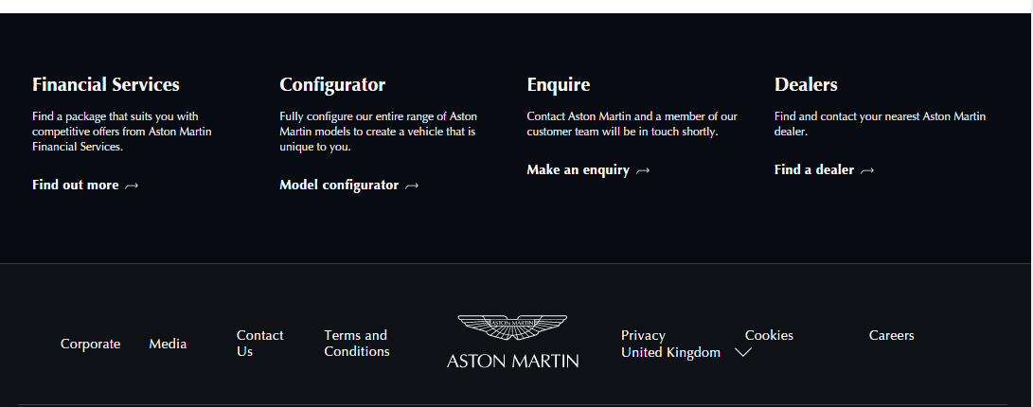
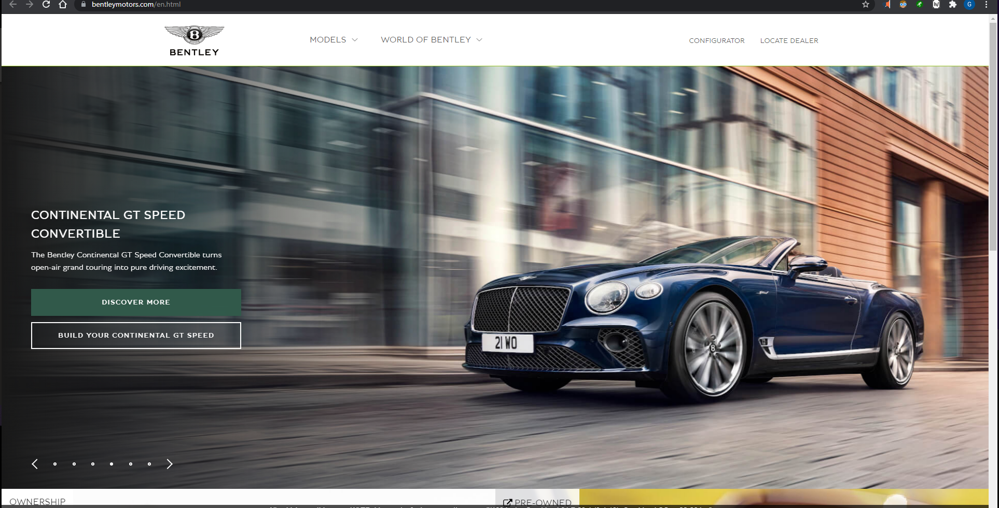

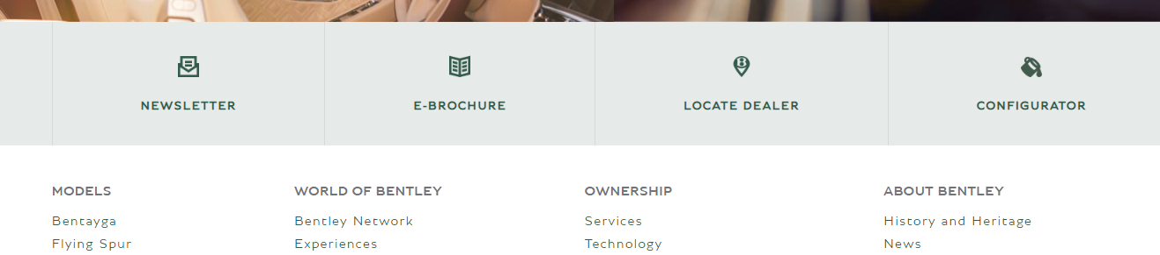
Tabbed navigation with underline changing strength when active – uses ::after (abs pos) for active link with height 1px->3px and change of bgcolour. Used onClick event to manage scroll with js.
Text-transform: uppercase
Optima(paid), Times New Roman, Times, sans-serif;
Nav link – scrolls down
Mouse = small circle, gets larger when hovered over link/button
footer

Slide 8
Include obvious references to phone & multiple screen sizes etc.

Slide 9
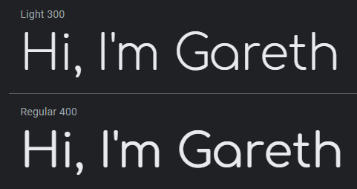




fonts
Comfortaa
Amstrad CPC464
(not from google)
Righteous
Coda
Optima (paid font – nope!)

